Slide 1
Network Management for WSN

Slide 2
Outline
Introduction
Network Management Requirements
Traditional Network Management Models
Network Management Design Issues
Example of Management Architecture: MANNA
Other Issues Related to Network Management
Naming
Localization

Slide 3
Introduction
Network management is the process of managing,
monitoring, and controlling the behavior of a network.
Wireless sensor networks (WSNs) pose unique
challenges for network management that make
traditional network management techniques impractical.
A network management system designed for WSNs should provide a set of management functions that integrate configuration, operation, administration, security, and maintenance of all elements and services of a sensor network
Application
Transport
Network
Data Link
Physical

Slide 4
Network Management Requirements
A computer communication network generally consists of three components:
Physical devices
Links (wireless or wired link),
Network nodes (hub, bridge, switch, or router), and
Terminals and Servers;
Protocol; and
Information that is being carried, including applications.
The collaboration of physical devices and network protocols forms the underpinning support for the applications. However, the physical devices and protocols are not sufficient to support effective operation of a communications network; network management (NM) tools and techniques are also required to help provision network services and ensure cooperation of entities in the network.

Slide 5
The reasons for management functions
There are many heterogeneous devices and software entities that comprise the network, and some may fail.
Optimization of system performance as a distributed system require NM to collaborate in the process.
For most networks, NM functions can be used to gather and analyze the behavior of user interaction during network interface, which is very important in planning the long-term evolution of network capacity and its performance.

Slide 6
Traditional Network Management Models
Simple Network Management Protocol
For managing networks, SNMP is broadly use today.
It includes three components:
Network Management System (NMS),
Managed Elements, and
Agents.
Role of NMS :
NMS is a set of applications that monitor and/or control managed elements.
NMS can request management information/attributes from the agent.
NMS present the results to NM users in figures/tables form.
NMS can also set attributes within the agent.

Slide 7
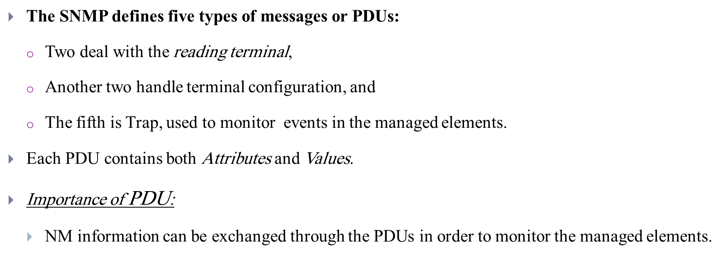
Role of Managed Element :
SNMP agents run on each managed element.
The managed elements:
Collect & Store management information in the MIB and
Provide access through SNMP to the MIBs.
managed elements include: Routers, Switches, Servers, and Hosts.

Slide 8
Advantages of SNMP:
Its very simple and widely deployment.
In SNMP version 3 it can obtain more information by a pair of PDUs such as (GetBulkRequest and GetResponse).
Disadvantages of SNMP :
It consumes considerable bandwidth since it often gets only one piece of management information at a time: GetRequest (GetNextRequest) and GetResponse.
Due to the usually large number of managed elements, large bandwidth consumption still exists.
It only manages network elements; it does not support network-level management.

Slide 9
3.2 Telecom Operation Map
It is based on the Service management Network management process models.
TOM presents a model for telecommunications management for network and service management and a view of ‘‘operations.’’
IDEA: To introduce processes comprising operations and their automation.
TOM only provides a framework for service management.
Levels / Layers for service management
Horizontally Layers
Service Fulfilment,
Service Assurance, and
Service Billing.
Vertical Layers
Network and Systems Management,
Service Development and Operations, and
Customer Care Process.

Slide 10
Network Management Design Issues
Several issues must be addressed carefully before designing network management tools for WSNs. To begin with, the management functions required for WSNs should first be identified
Basic Issues:
Power efficiency
Data centric
Data aggregation
Attribute-based Addressing
Locationing systems, and
External Networks

Slide 11
Factors to be consider while designing a Network Management Protocol
Management solutions should be energy efficient, using as little wireless
bandwidth as possible since communication is highly energy demanding.
Management solutions should be scalable. This is especially important since it future WSNs may consist of tens to thousands of nodes.
Management solutions should be simple and practical since WSNs are
resource-constrained distributed systems.
MIB for WSNs should contain a general information model for sensor nodes,
features of WSNs, and WSN applications.
Management solutions for WSNs should provide a general interface to the applications since applications can perform better when able to access
management information.
Management solutions should be implementable as middleware.

Slide 12
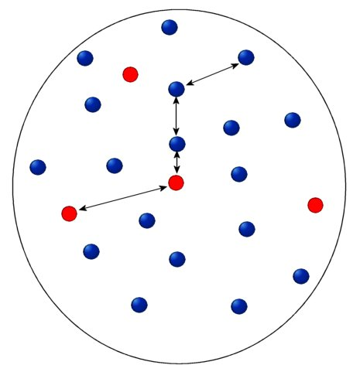

WSN Communications Architecture
Sensing node
Sensor nodes can be
data originators and
data routers
Internet
Sink
Manager Node
Sensor nodes
Sensor field

Slide 13
Example of Management Architecture: MANNA
MANNA (a Management Architecture for Wireless Sensor Networks ) is a policy-based management system that collects dynamic management information , maps this into WSN models, and executes management functions and services based on WSN models.
MANNA defines the following managed object classes:
Network (information on network behavior and features such as data delivery model, network structure, and mobility)
Managed Elements(such as sensor nodes)
Equipment (the physical components of sensor nodes)
System (information on operating system)
Environment (the environment the WSN is running),
Phenomenon, and
Connection.

Slide 14
MANNA: common management functions for WSNs:
environment monitoring functions, a coverage area supervision function, a topology map discovery function, an energy-level discovery function, an energy map generation function, and several others.
It also provides a dynamic MIB model for WSNs: a sensing coverage area map, a communication coverage area map, a WSN behavior model, a node dependence model, network topology, residual energy, and so on.
In MANNA, the management functions have the lowest granularity and can be combined into management services.

Slide 15
Some examples of WSN models:
Topology map depicting node connectivity and reachability of the network.
Residual energy map showing battery level of nodes in the network.
Sensing coverage area map describing the area covered by sensor elements.
Communication coverage area map presenting communication range of nodes in a network.
Audit map describing the security status of sensor nodes in a network, whether nodes have been attacked.

Slide 16
Other Issues Related to Network Management
There are several other issues related to sensor network management, the most important being
naming,
localization,
maintenance, and
fault tolerance.

Slide 17
Naming is the scheme used to identify a sensor node.
An efficient naming scheme can lower computation overhead and make routing
protocol energy efficient.
Localization schemes determine the location of sensor nodes since such information is important for some sensor applications.
The maintenance issue may involve actions such as replacing batteries, keeping connectivity, and configuring sensor nodes.
-The maintenance activity is used to maintain normal operation of the entire
network for as long as possible.
Several factors can cause faults in network operation, including hardware and software error. Therefore, different schemes must be implemented to provide fault tolerance.

Slide 18
Naming
Naming is the scheme used to identify a sensor node.
An efficient naming scheme can lower computation overhead and make routing protocol energy efficient.
There are two traditional approaches to naming:
low level: naming such as node addresses is typically application independent but topology and location dependent
high level: naming is usually application dependent
and location independent.
High-level naming is built on the top of low-level naming.

Slide 19
Localization
Localization schemes determine the location of sensor nodes since such information is important for some sensor applications.
Advantages of this knowledge are that :
some applications, such as those for tracking of objects, are highly location dependent
location-based routing, which may also result in energy conservation is enabled
knowledge of location usually enhances security;
locations are helpful for sensor network management and monitoring

Slide 20
locations stimulate the creation of new applications
sensor nodes that move can be controlled through knowledge of their location and
for applications with low-level naming and/or data-centric WSNs, knowledge of location information is absolutely necessary.

Slide 21
Localization classification
Localization Algorithm
Centralized Schemes
Distributed Schemes
Range-based Scheme
Range-free Schemes

Slide 22
Centralized Scheme
In this scheme Sensor nodes send control messages to a central node whose location is known.
The central node then computes the location of every sensor node and informs the nodes of their locations.
Distributed Scheme
Each sensor node determines its own location independently.
The distributed localization can be further grouped into:
Range-based schemes and
Range-free schemes.

Slide 23
In the range-based approach, some range information, such as time of arrival, angle of arrival, or time difference of arrival is required.
The range-free algorithms works as follows:
Several seed nodes are distributed in WSNs.
Seed nodes know their own locations, and they periodically broadcast a control message with their location information.
Sensor nodes that receive these control messages can then estimate their own locations.

